Slide 1
BECKMANN REARRANGEMENT.
By: Caron Sally Pereira and Abigail Fernandes Golias.

Slide 2
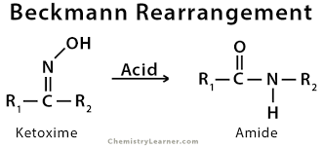
The Beckmann Rearrangement is a rearrangement type of reaction that rearranges a Ketoxime to a N-Substituted Amide with the help of an acidic reagent at high temperatures.
Ketoxime N-Substituted Amide

Slide 3
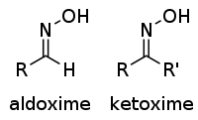
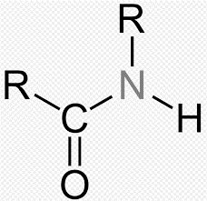
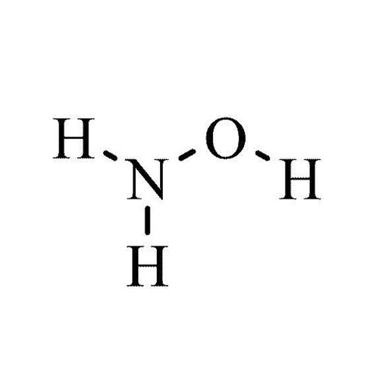
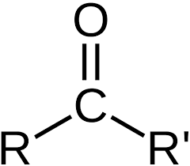
N-Substituted AMIDE
Structure:
KETOXIME
Structure:
A ketoxime is an organic compound formed by the reaction of ketone with hydroxylamine.
Ketoxime N-Substituted Amide
N-substituted Amide is an organic compound having functional group as : -CONHR’
i.e,
+
ketone
hydroxylamine
ketoxime

Slide 4
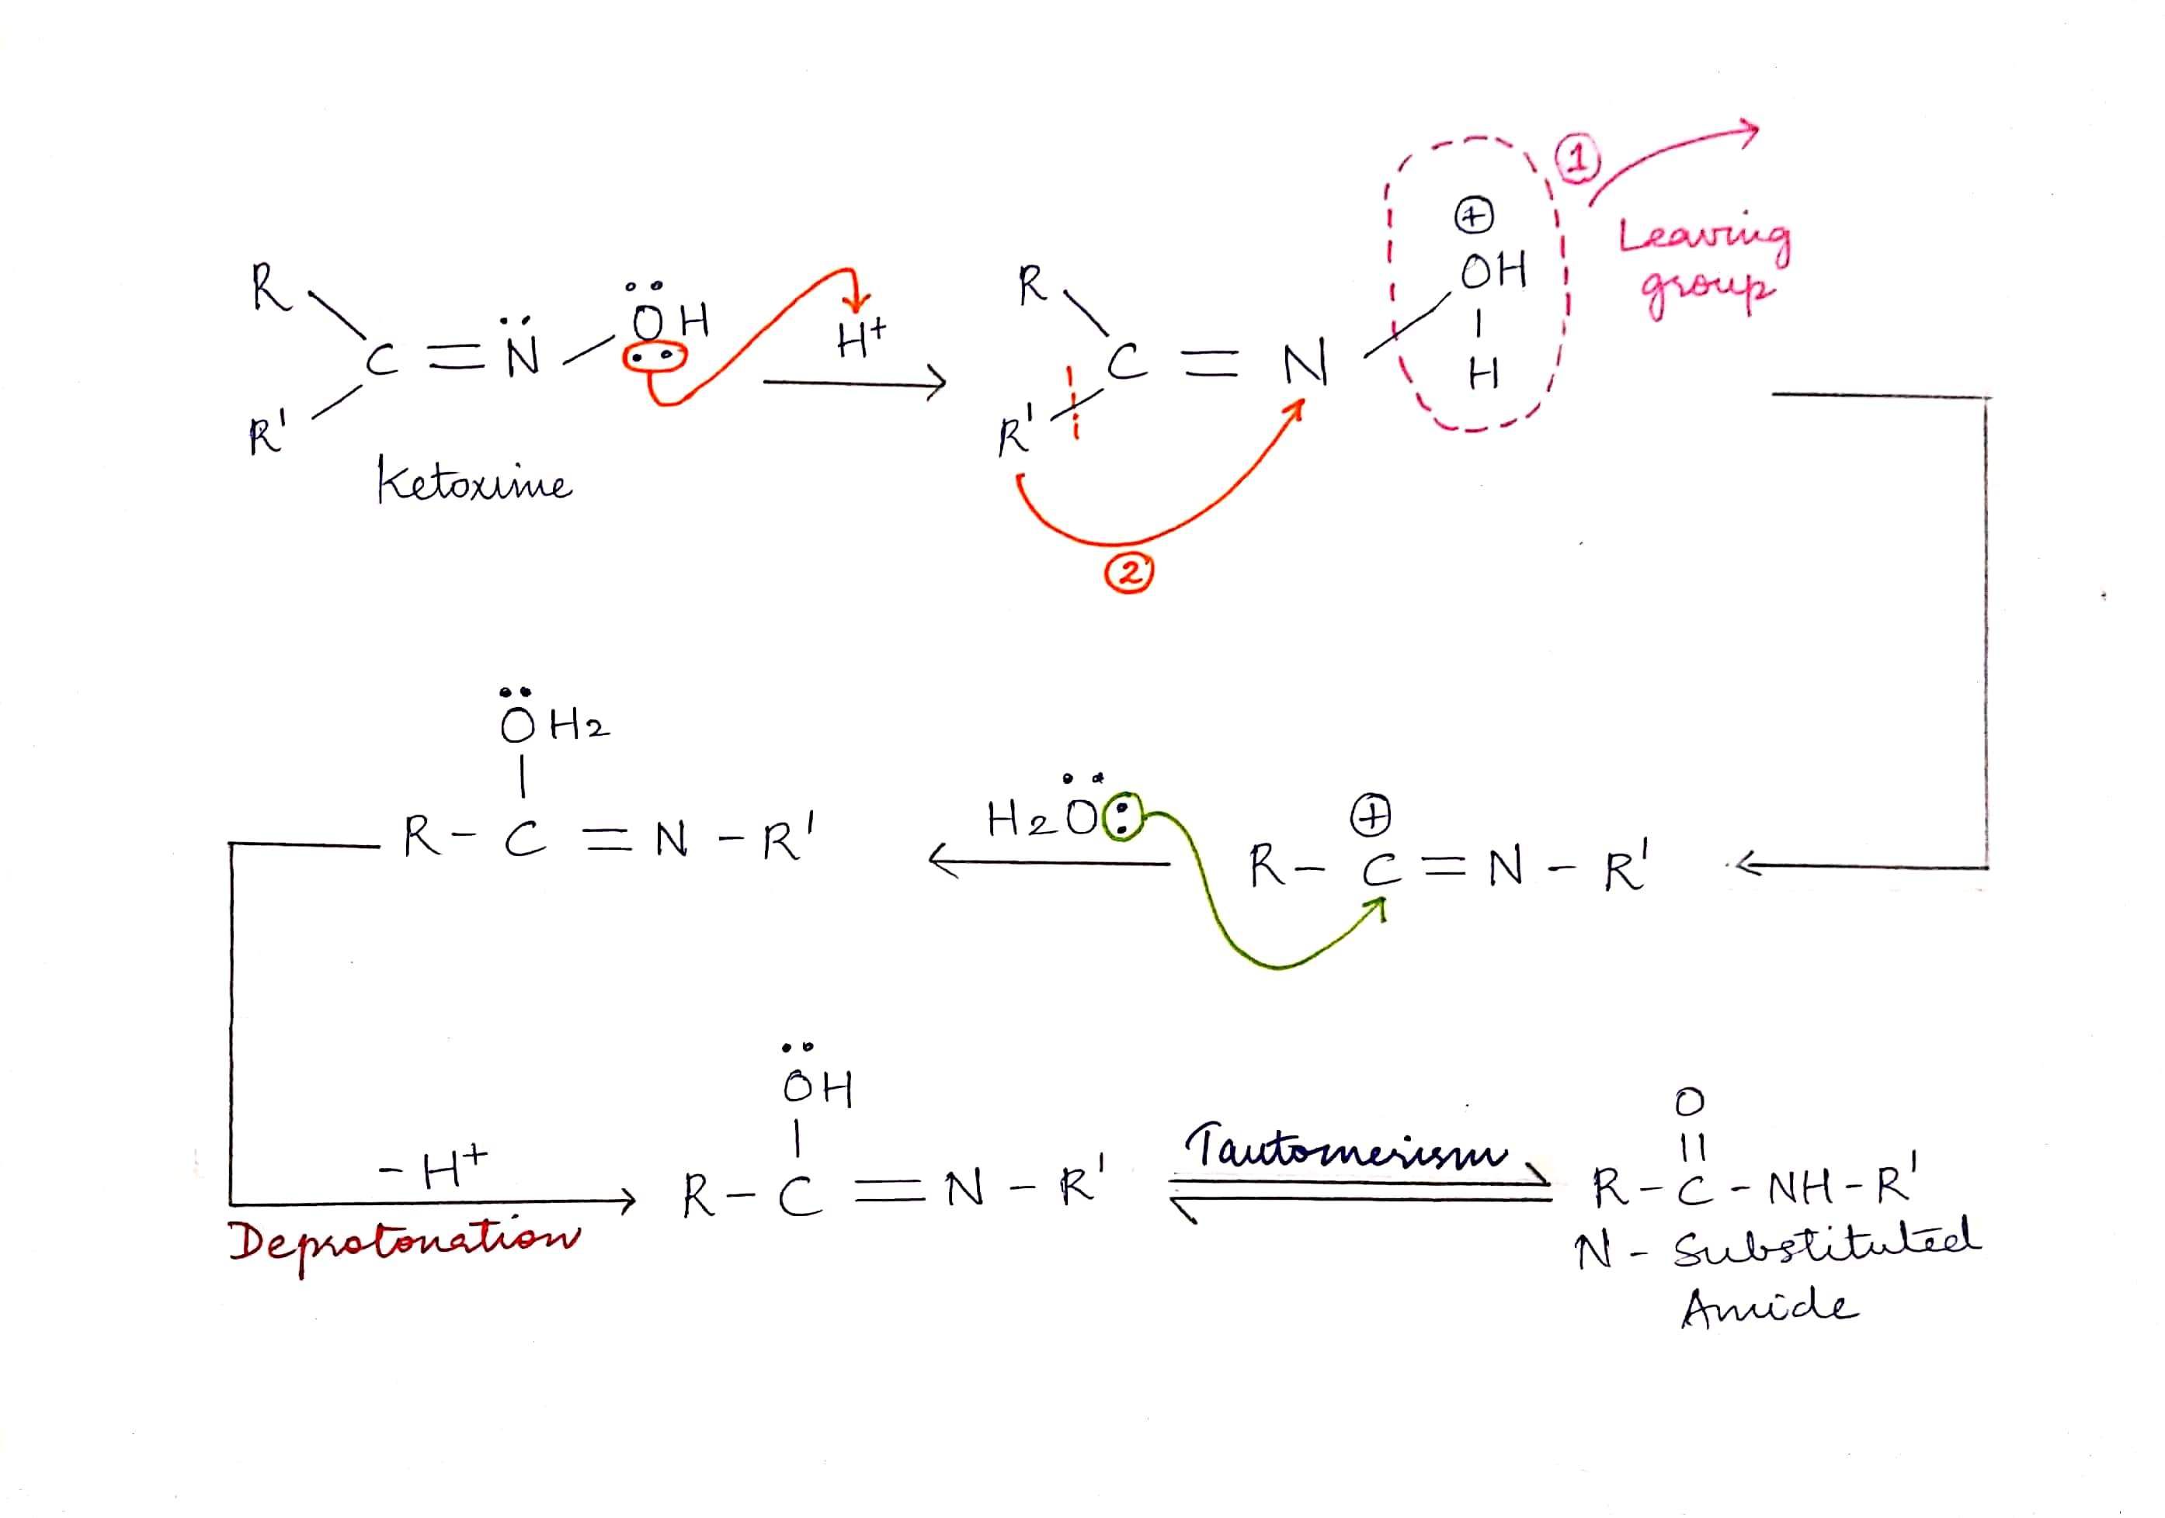
MECHANISM
The Beckmann Rearrangement takes place in the following steps:

Slide 5
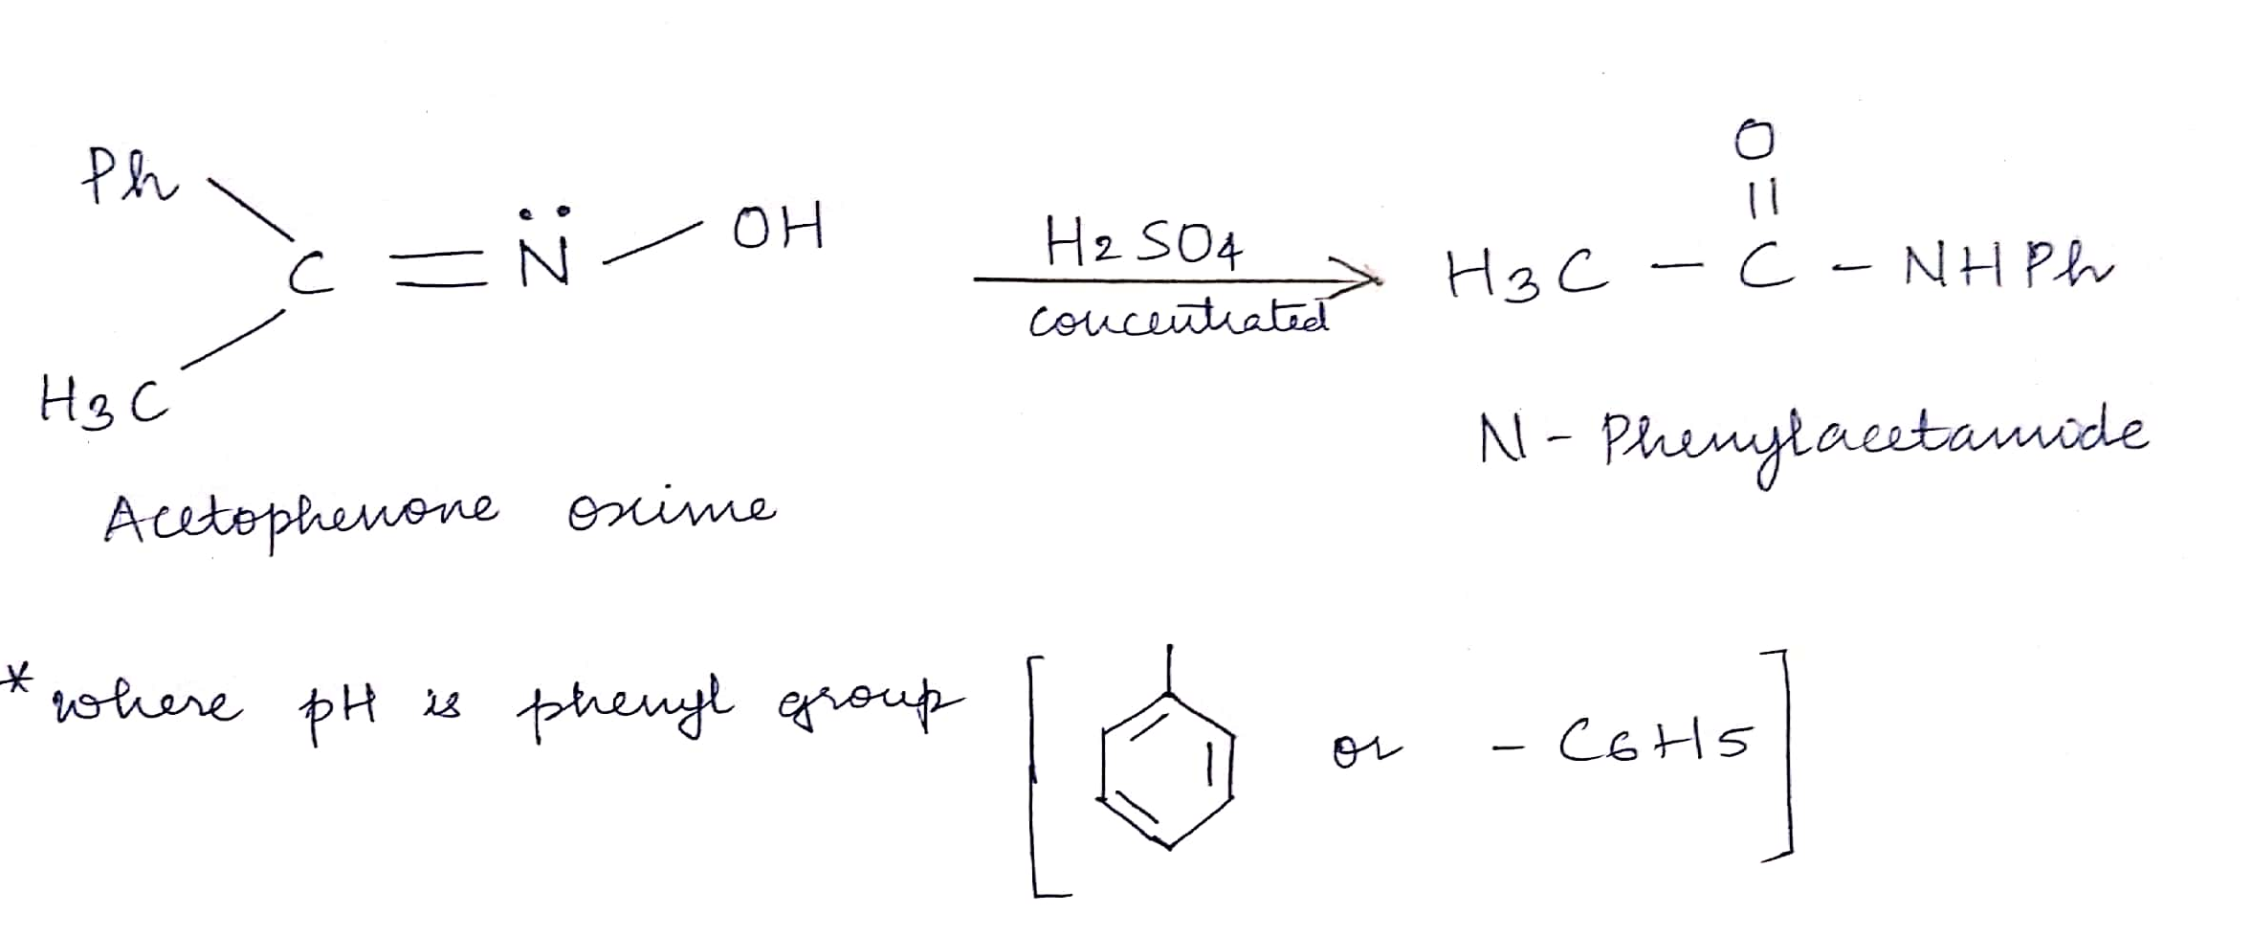
For example:
Conversion of Acetophenone Oxime to N-Phenylacetamide

Slide 6
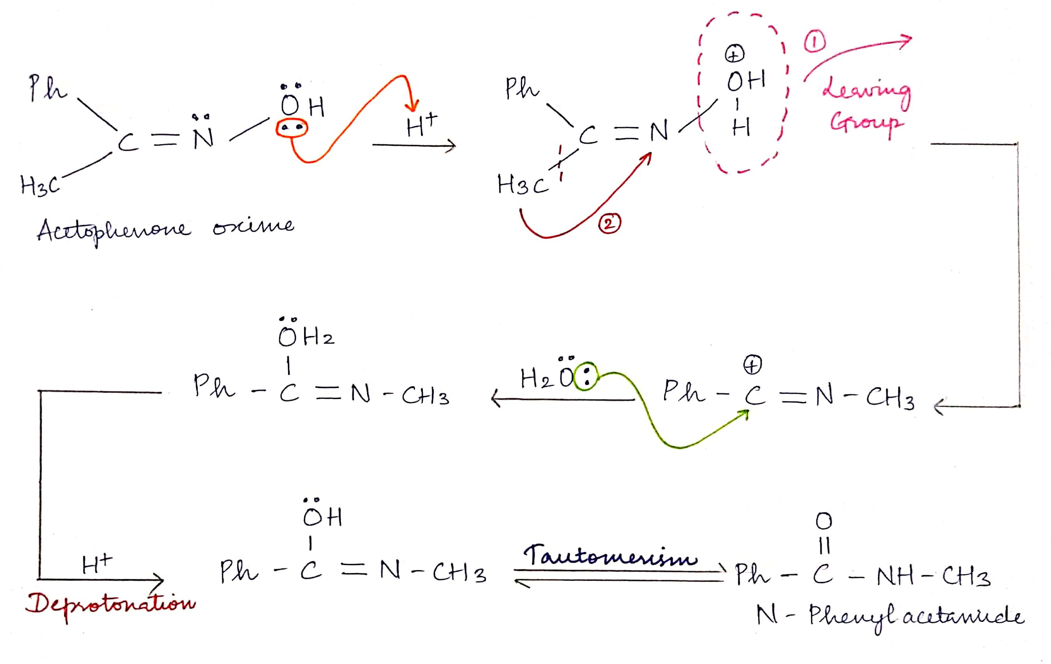
Mechanism of the example:

Slide 7
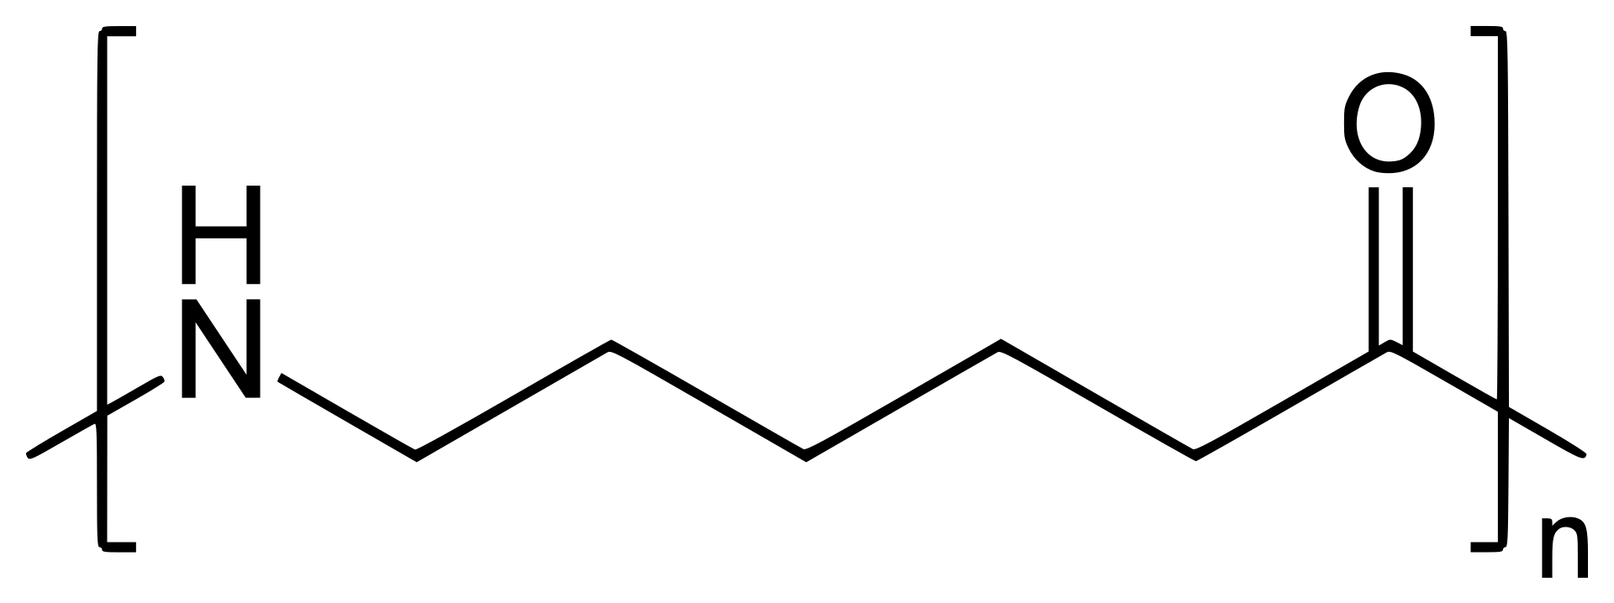
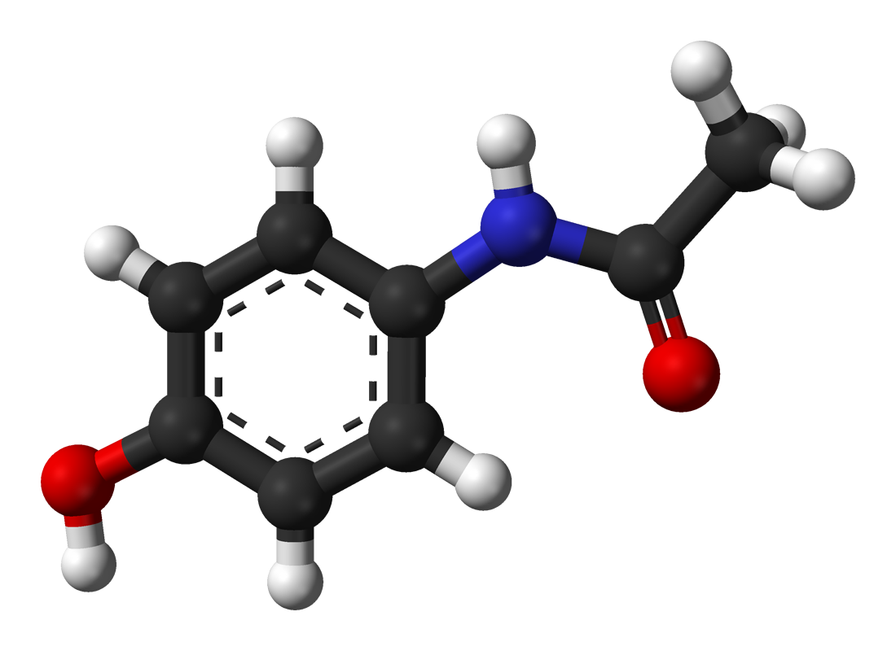
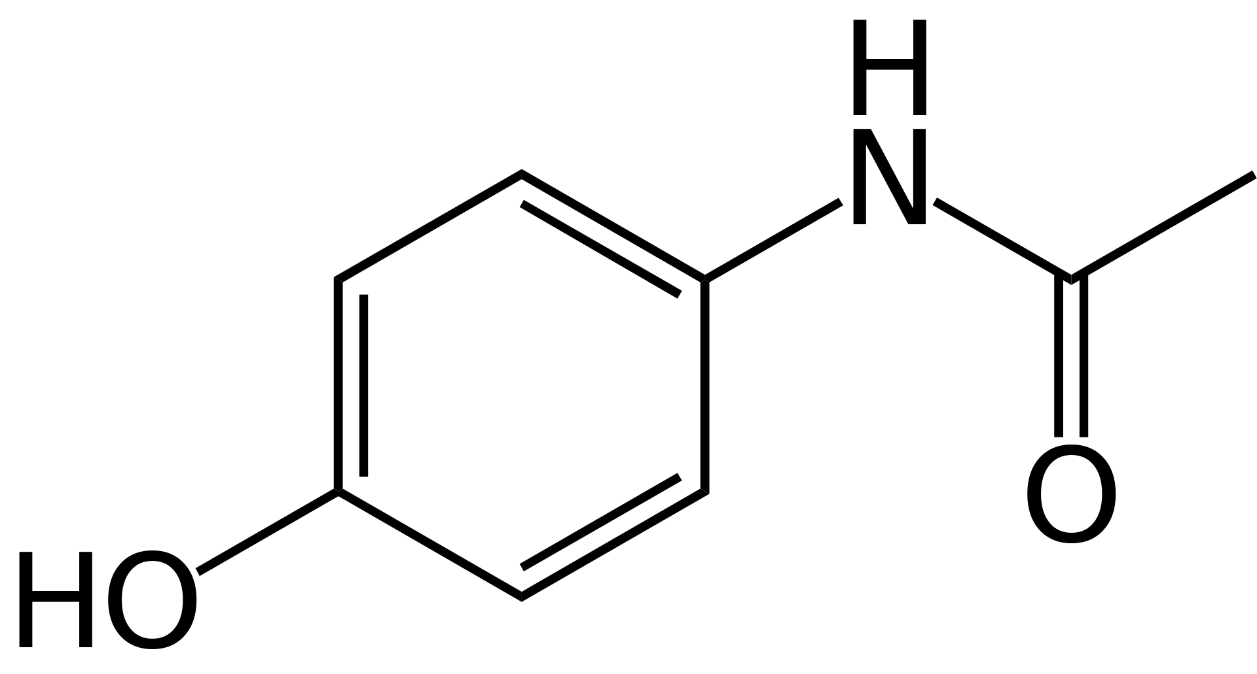
APPLICATIONS:
It is used in the production of raw material for Nylon 6.
It is used in the manufacture of Drug Paracetamol.

